Slide 1



DAY 8: DEMO DAY!
PRESENTATION SKILLS & PROJECT SHOWCASE
Show Off Your Amazing AI Creations! Today is your time to shine!

Slide 2


WHY ARE PRESENTATIONS IMPORTANT?
Sharing your project helps others see your hard work and learn from you. It's fun to tell your story and show what you created!
⭐ Helps you explain your ideas clearly
⭐ Builds your confidence speaking in front of others
⭐ Inspires friends with your cool project

Slide 3
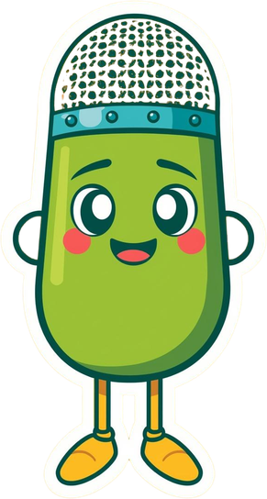
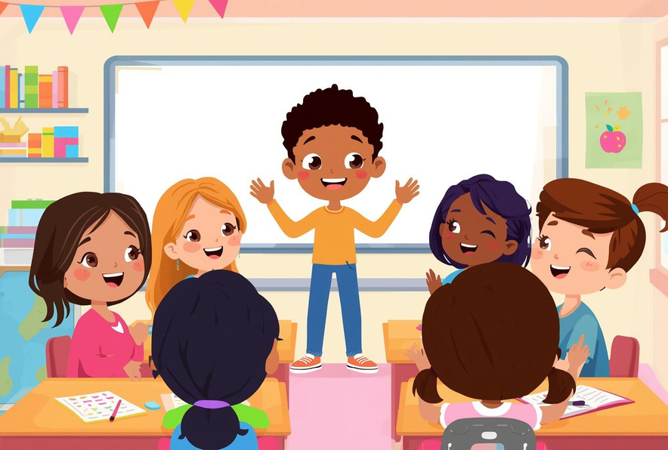

TIPS FOR A GREAT PRESENTATION
1
Speak Clearly: Use a loud, friendly voice so everyone can hear you!
2
Make Eye Contact: Look at your audience to connect with them!
3
Take Your Time: Don't rush — it's okay to pause and breathe!

Slide 4

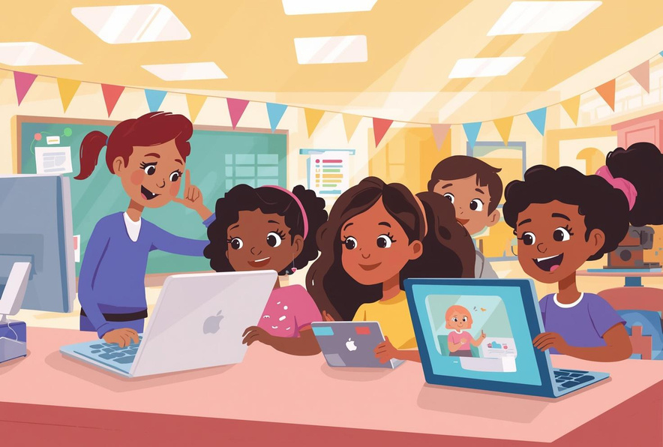

WHAT TO INCLUDE WHEN YOU SHOWCASE
1
What I Made: Describe your Teachable Machine model or Scratch game. Tell everyone about your awesome creation!
2
How It Works: Explain how your project does what it does. Share the cool steps that make it run!
3
What I Learned: Share something new you discovered or a skill you gained. What was fun or challenging?

Slide 5
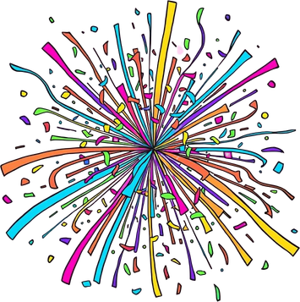


YOU'RE ALL
WINNERS!

